Slide 1
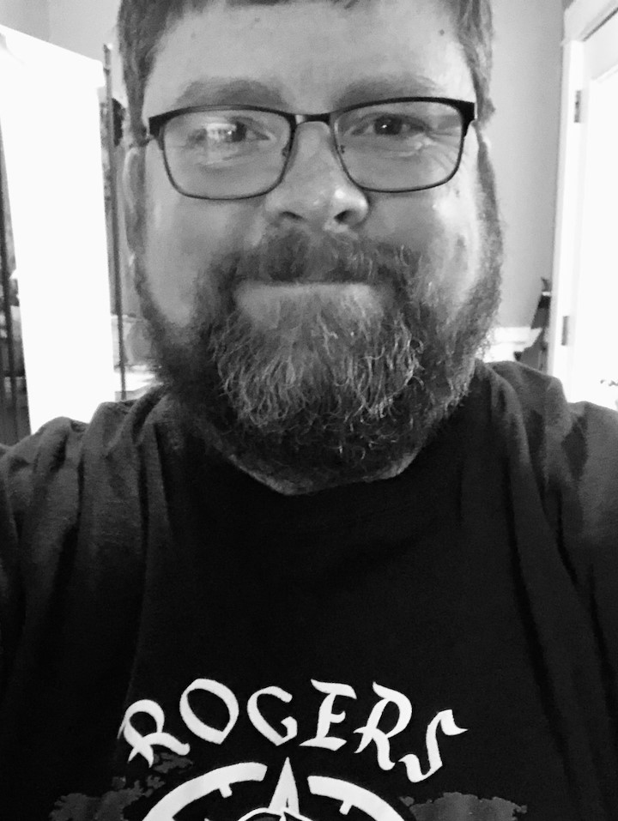
APUS History
Mr. Sylling

Slide 2
APUS History
Focus of Class:
Content: American History from 1491 to the Present
Reasoning Skills: Comparison, Causation, Continuity and Change
Historical Thinking: Processes, Sourcing, Claims and Evidence, Contextualization, Making Connections, Argumentation
Exam Date: May 5, 2023

Slide 3
Mr. Sylling’s Classroom Expectations
Work hard and do your best
Follow the John R. Rogers 3 Rs
Respect: be respectful (even if you are having a tough day)
Responsibility: be present (on time and with your brain as engaged as it can be) and prepared (with materials and homework) and participate even when its difficult (it is okay to struggle)
Relationships: be kind to students, staff, visitors and yourself
Be a good citizen and thoughtfully respect and follow through on expectations in the John R Rogers Student Handbook. This includes use of hall passes, use of electronic devices, dress code, etc.

Slide 4
APUS History
Mr. Sylling
Contact Information:
Phone:
509-354-6662
Email: ericsy@spokaneschools.org

